Slide 1
Voices of North Carolina
Webinar 3: Social Dialects
April 5, 2011

Slide 2
Preview of webinar
Language/dialect endangerment (review)
Lumbee history, culture, and language
African American English: Origin, development, and current configuration
(Time permitting) Spanish, dialect, and Teaching English as a Second Language
Response to questions
Introduction to the final project

Slide 3
Language Endangerment
90% of the world’s language approximately 6,000-7,000 languages will become extinct during the twenty-first century
There are 192 endangered Native American Languages in the United States
California has lost more than 50 languages during the last century
By comparison, 8% of mammals are endangered and 3% of birds are endangered
When a language dies, history, culture, and essential scientific data are lost

Slide 4
Why Languages Die
Economic: “for endangered languages one must take into account the potential of economic issues to outweigh all others combined” (Grenoble and Whaley 1998:31). Relinquishing a native language variety is tied to the belief that success in another language is crucial for economic survival and advantage.
Political: asymmetrical relations of power between different ethnic and social groups
Ideological: assumed belief systems and underlying values about language use and diversity.
Ecological: geographical location and physical environment, as well as population demographics

Slide 5
The Sociohistorical Context
With 55,000 members, the Lumbee are the largest Native American group east of the Mississippi River and the largest non-reservation group in US
Recognized (1956) but with no federal entitlements
A longstanding tri-ethnic situation (2010 census data)
Native- American (38%)
European American (36%, including 9% Hispanic)
African-American (24%) contact groups
Early loss of Native American language(s); English-speaking since 1700s
Ancestral language uncertain; may have formed from a multilingual conglomerate

Slide 6
The Sociohistorical Setting
Agrarian setting (tobacco & cotton historically)
Largely segregated in some locales
Persistent struggle for full recognition by the government, other Native American groups, and the general public
First Native American group recognized in North Carolina (1880s)
History of name change: Croatan, Cherokee, Robeson County Indians, Lumbee (folk etymology from Eastern Catawban word, [ya’be] ‘side of the river’

Slide 7
Robeson County

Slide 8
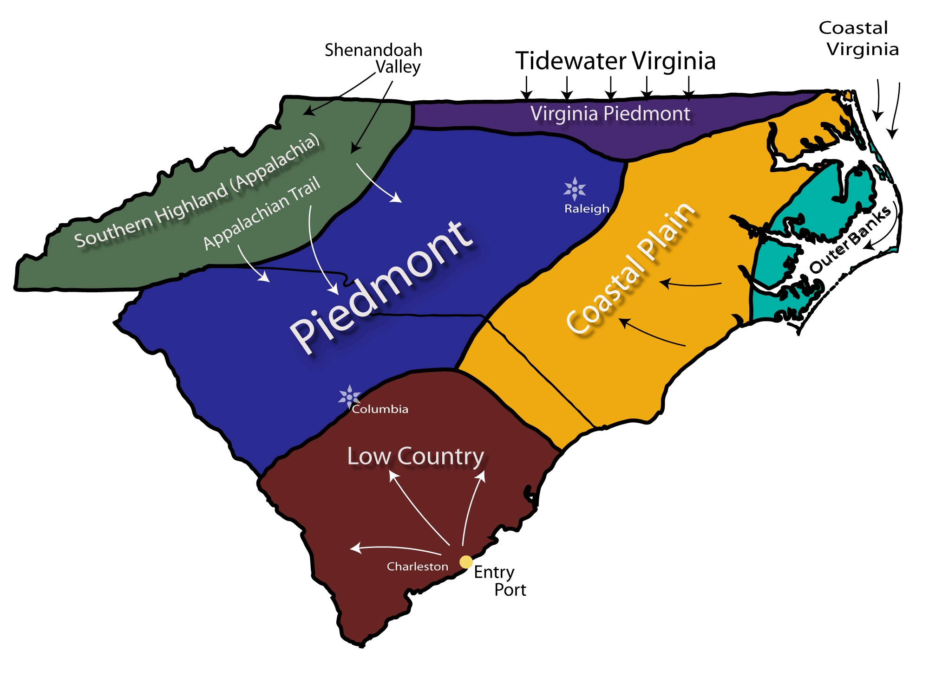
The Local Dialect Context
Lumbee

Slide 9
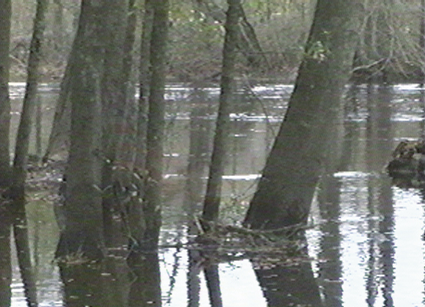
The Quest for Identity
“The Lumbees’ century-long quest for identity is a story as serpentine as the jungled Lumber River, whose swampy course shielded, and perhaps even created them and their ambiguous world. There is, in fact, nothing at all about the Lumbees that fits conventional notions of what it means to be Native American. Yet for as long as any Lumbee can remember, they have possessed an unflagging conviction that they are simply and utterly Indian, a tenacious faith that is troubled only by the failure of most other Americans to recognize it.”
(Bordewich Killing the White Man’s Indian 1996:62-63)

Slide 10
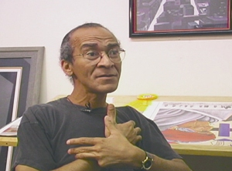
Lumbee Dialect and Identity
“[The dialect] is how we recognize who we are, not only by looking at someone”
“We know just who we are by our language. You recognize someone is from Spain because they speak Spanish, or from France because they speak French, and that’s how we recognize Lumbees.”
(35-year-old Lumbee artist)

Slide 11
Sample: Robeson County Lumbee
(70-year-old Lumbee woman, Prospect)
And, children, there come a man in the big broad daylight. I could see him as pretty as I'm a-lookin' at you. Come all the way down that ditch bank. I says to myself, I says, I kept a-lookin' at the man; he was a-lookin' in the ditch just like there was somebody in there ditchin'. You know how a man would walk. Could you imagine a man--two men in the ditch a-ditchin' and a man a-walkin' down side of that ditch a-lookin' at them in there throwing that dirt?

Slide 12
Sample: Robeson County Lumbee
(70-year-old Lumbee woman, Prospect)
That's just the way he was a-lookin' into this ditch, this man was, in the broad open daytime. And, honey, he come right on down that ditch. And I spoke and I says, "How in the world did Uncle Pat get through in here by mule?" I knew he couldn't 'cause there wasn't but one road a-comin' into my place, back in them woodses. I says "He couldn't, I don't see no car nor nothin'."

Slide 13
Sample: Robeson County Lumbee
(70-year-old Lumbee woman, Prospect)
And when he got to the--uh, crossed this ditch. He crossed the ditch and went halfway to the field and come on down this other ditch. There was a little path through, went through my yard and went all across the woodses there. Well, when he got halfway to that little ditch on this side, before it come out here to the road. I was a-lookin' at him plumb good. Honey, just as su-by the time you-

Slide 14
Sample: Robeson County Lumbee
(70-year-old Lumbee woman, Prospect)
just as say, if you'd have said to me, "Lucille, that's Harley Locklear." Honey, I ain't never got so--He had on a brown coat, he had on a pair of brown britches, he had on a brown hat, just like if you'd have spoke to me and said, "Lucille, that's Harley Locklear." Honey, I ain't never got so scared in all the days of my life.

Slide 15
Sample: Robeson County
Younger Lumbee
(11-year-old boy, Prospect)
One time we was watching this game on T.V. and we heard this knock on the door. So the man come in--it was a man that we never had seen him before--he come in and he says, "Can I use your telephone? Can I use your telephone?"

Slide 16
Sample: Robeson County Younger Lumbee
(11-year-old boy, Prospect)
And he had his shirt tied in a knot and he had something back there and it was sticking up. He'd bend over on the table like this and it would stick up in his back pocket. So my brother Ronnie, he asked him what was that in his back pocket, and he said, "That's my flashlight!"

Slide 17
Sample: Robeson County Younger Lumbee
(11-year-old boy, Prospect)
And then he went in the woods, in the woods beside our house, and he got down in the woods, like, on his knees. And we got this BB gun and there was this dog that come to our house, and Ronnie Allen tried to shoot him with the BB gun, but he missed the dog. But the man jumped up a-runnin', and then... The man's hand was a-bleedin',

Slide 18
Sample: Robeson County Younger Lumbee
(11-year-old boy, Prospect)
so Ronnie come back in the house and he says, "Good night, I believe I shot that man in the hand!" And then the next day we went outside; he had went in our truck and in our car. And the flashlight he was talkin' about, it come out of our car. He stole it out of our car.

Slide 19
Sample: Robeson County
African American
(60+ year-old African-American woman, Maxton)
People don't sing no more. I tells the people, the people at our church, until we get back to singing something to the Lord, I don't know if Jesus understands what people singing today, cause I don't understand it, I'm not Jes- I don't understand. You hear all this loud music and you don't hear no words.

Slide 20
Sample: Robeson County African American
(60+ year-old African-American woman, Maxton)
But we need to sing something that's understanding so that we can sing praises to the Lord. Now I'm not saying it might be, he-, he- he-, he's-, he can hear all things, you know, because he ís, he ís all in all, and I know he understand.

Slide 21
Sample: Robeson County African American
(60+ year-old African-American woman, Maxton)
But I still think we ought to serve the Lord wi-,wi-wi, with songs that sings praises to him. Cause you know it's something lacking in our churches and I believe that's what it is. And our men folks are not interested; they need to be there. The beautifulest time I ever seen I went to a church out from Lillington, North Carolina.

Slide 22
Sample: Robeson County
Anglo American
Now I've got Canada geese out at my pond and they're, they're wild geese, they're not pen raising out there. And there's, there's a coup-- a pair of them now who was hanging around and getting ready to-to nest out there. Cause the last five years they have--this same pair has been nesting out there on the bank of the pond.

Slide 23
Sample: Robeson County Anglo American
(74-year-old Anglo-American man, St. Paul's)
And the one year, some kind of varmint tore their nest, well two years, when the bank of the, uh built their nest on the east side the pond, some kind of varmint, I don't know, fox or a coon or a possum, something got tore the nest all to pieces and tore up the eggs.

Slide 24
Sample: Robeson County Anglo American
(74-year-old Anglo-American man, St. Paul's)
And they didn't reset, but the times that they have nested on the west bank, now you could walk right up, I'd walk up to them, get as close as I am to your feet. She'd just set there, course she doesn't want me to be there, but she won't move. The old gander a-blew at me.

Slide 25
Sample: Robeson County Anglo American
(74-year-old Anglo-American man, St. Paul's)
But uh, she's hatched five once and six twice, but I know that you--now when they hatches those birds, the last hatch last year. I reckon I was there late in the afternoon looking at her, and I knew it was about time.

Slide 26
Identification of Lumbee Speakers
Regional Group | Correct Speaker Identification Lumbee | Correct Speaker Identification Anglo American | Correct Speaker Identification African American
Robeson County (N=41) | 81% | 74 % | 95%
Raleigh, NC (N = 37) | 38% | 80% | 91%
 | χ² = 56.957; p < .001 | χ² = 1.585; p =n.s | χ² = 1.216; p = n.s.

Slide 27
The Reconfiguration of “Relic” Forms: Perfective be in Lumbee English
“I’m been there” for “I’ve been there”
A common dialect trait across many earlier dialects of English
“Hither by thy help I’m come” (KJV Bible)
Perfective be and have fluctuated well into the seventeenth century
In Lumbee English, perfective be remains a robust, productive form, even among younger Lumbee.
Lumbee English expands perfective be to simple past (e.g., “I’m forgot” for “I forgot”)
This expansion is unique to Lumbee English

Slide 28
Persistence and Accommodation: Finite bes in Lumbee English
“That’s how it bes sometimes”
A peculiar regional trait of southeastern NC and northeastern SC of disputed origin
Among younger Lumbee speakers, it is converging with ‘habitual be’ in African American English while retaining its finite status

Slide 29
Accommodating the shifting status of finite be in Lumbee English
Age | No. habitual/Total e.g They always be here | be +VERB + ing e.g. They be laughing
35 and Above | 32% (8/25) | 12% (3/25)
Below 35 | 76% (25/33) | 45% (15/33)
Chi square | 11.02; p < .001 | 7.54; p < .01

Slide 30
The Adoption of a Regional Feature: Regularized weren’t
I weren’t there; she weren’t there
A peculiar Coastal regional feature; evidence of more recent development.
In Lumbee English, the use of regularized weren’t remains a robust, productive form, intensified among some younger Lumbee speakers.

Slide 31
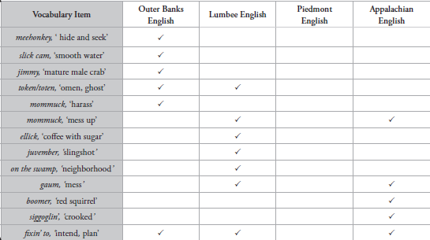
Comparison of Dialect Vocabulary

Slide 32
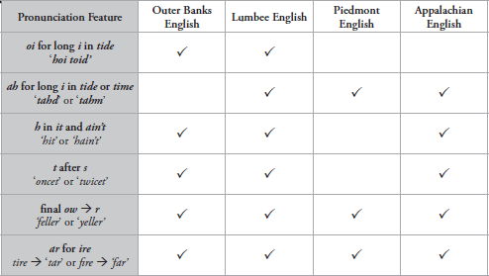
Comparison of Pronunciation Features

Slide 33
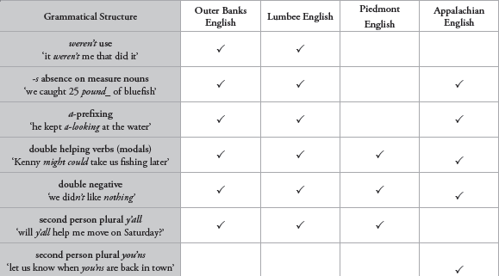
Comparison of Grammar Features

Slide 34
Conclusions
A unique set of donor language sources, combined with the dynamics of language adaptation, accommodation, and innovation, converged to mold a distinct ethnolinguistic variety of English within the Lumbee community.

Slide 35
Conclusions
Lumbee language identity is locally situated, constrained by the bi-racial ideology of the American South. Patterns of segregation, population density, and historical continuity are implicated in the process.
…But there is also an important sense in which the construction of cultural “otherness” and “Indianness” factors into their development and maintenance of dialect identity.

Slide 36
Conclusions
The sociolinguistic situation of the Lumbee has exposed them to a type of double jeopardy. Having lost their native language or languages due to the sociopolitical and economic exigencies of early European encroachment, their unique dialect is now subjected to the principle of linguistic subordination in which it is simply dismissed as “bad” English.

Slide 37
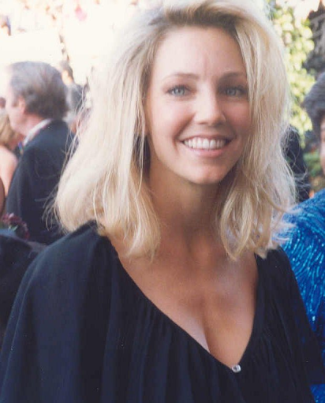
Conclusions: Fluid Lumbee Identity
“I mean, you know, this Heather Locklear thing, Heather Locklear ain’t no Lum, I don’t care what nobody says, I don’t care if her granddaddy or great granddaddy or what-what came from here. She’s never lived as a Lum, she’s never been involved in this community, she’s never certainly had to experience the things that are just gonna be a part of your life experience if you are a Lum and live in Robeson County… you just gotta be a part of this culture, even if it is from a distance. I guess what I’m trying to say is that you gotta have the genetics and the culture.” (from Hutcheson 2001)

Slide 38
Conclusions: Recognition
“Whereas by reason of tribal legend, coupled with a distinctive appearance and manner of speech... shall, from and after the ratification of this Act, be known and designated as Lumbee Indians of North Carolina”
(from Act Relating to the Lumbee Indians of North Carolina, Congress of the United States, June 7, 1956)

Slide 39
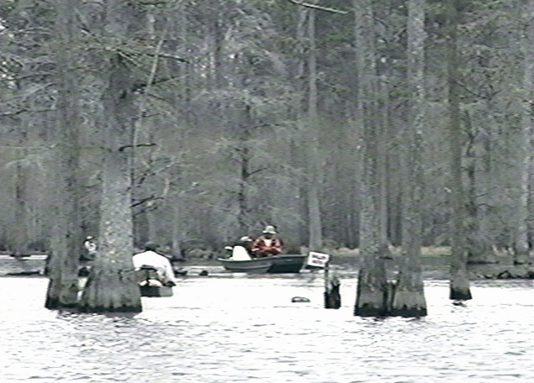
title
In reality, the perpetuation of an regionally situated, ethnically distinct variety is a testament to the sociolinguistic adaptability, resiliency, and vitality of the Lumbee language community.
text

Slide 40
Myths about African American English
AAE is bad or broken English
AAE is just slang
All African Americans speak AAE
Only African Americans speak AAE
AAE is genetically based
AAE speakers all sound the same
AAE speakers cannot also use standard English

Slide 41
Review of Habitual BE
1. My mom be working
2. He be absent
3. The students be talking in class

Slide 42
Review of Habitual BE
1. a. 32 They usually be tired when they come home.
b. 3 They be tired right now.
2. a. 31 When we play basketball, she be on my team.
b. 4 The girl in the picture be my sister.
3. a. 4 James be coming to school right now.
b. 31 James always be coming to school.
4. a. 3 My ankle be broken from the fall.
b. 32 Sometimes my ears be itching.

Slide 43
Review of Habitual BE
1. a. 32 They usually be tired when they come home.
b. 3 They be tired right now.
2. a. 31 When we play basketball, she be on my team.
b. 4 The girl in the picture be my sister.
3. a. 4 James be coming to school right now.
b. 31 James always be coming to school.
4. a. 3 My ankle be broken from the fall.
b. 32 Sometimes my ears be itching.

Slide 44
Review of Habitual BE
1. My mom be working
→ “My mom works [a lot]”
2. He be absent
→ “He is absent [often]”
3. The students be talking in class
→ “The students talk in class [all the time]”

Slide 45
Review of Habitual BE
1. The students always be talking in class.
grammatical
2. The students don't be talking right now.
ungrammatical
3. Sometimes the teacher be early for class.
grammatical
4. At the moment the teacher be in the lounge.
ungrammatical
5. My name be Bill.
ungrammatical

Slide 46
Three Theories of AAE Origin
Creole – AAE began as a creole language mapping English vocabulary onto West African languages’ grammars (Gullah)
Anglicist – AAE was initially identical to the stigmatized dialects spoken by indentured servants and has since developed independently
Substrate – AAE was initially similar to regional white dialects, but did reflect some “substrate” influence related to differences in English and West African grammars

Slide 47
Visual of Theories of AAE history

Slide 48
Regional and Situational Differences in the Use of African American English

Slide 49
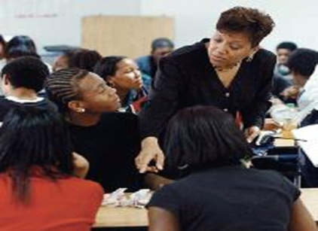
Roanoke Island Commissioner: Freedman’s Colony Celebration
So it’s only fittin’ that the Freedmen’s history that began here on Roanoke Island story be told and I’m going to share that with you. Many of you are certainly familiar with the Elizabethan heritage of Roanoke Island—Sir Walter Raleigh’s Lost Colony. We all know that the island was settled, uh, in 1587 and then that colony mysteriously disappeared. But far few people—fewer people are aware of Roanoke Island’s Freedman’s Colony and the role my ancestors and my family and friend’s ancestors played during the Civil War.

Slide 50
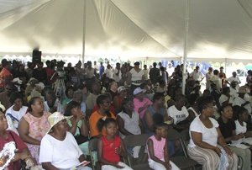
Princeville Mayor: Town Birthday Celebration
Praise God, I won’t be t- before you long, cause I-we want to hear from Reverend Lowery, but before we have him to come up I want to present the key to Princeville to him. Praise the Lord, we gonna spoil him while he here, he’s gonna want to come back. I tol’ him, I tol’ him on the way here, I say, “We gonna spoil you while you here, so you gonna want to come back to the town of Princeville.” First of all, I give honor to God, my Lord Jesus Christ, and we bring greetin’ from the Town of Princeville and the Board of Commission. You all can stan’ again. Yeah, we just want—this is honor for you, too, today

Slide 51
Roanoke Island Teenager: Making the Basketball Team
How the hell you gonna tell me, how you gonna tell me I’m not gonna make varsity, dog. You ain’t even gonna make the team.
[You crazy, I’ma-I’ma make the team, dog]
How much you wanna bet me, how much you wanna bet me, how much you want bet me, how much you wanna bet me, how much you wanna bet me?
[Mother: Woody…Woody! You need to listen]
I ‘on listen when somebody try an’ tell me I’m not gonna do some’n’
[Now, well look]
How gon- I’m makin’, I’m makin’ varsity. Put it down, put it down like dat. If I don’t make varsity I’m makin’ JV.

Slide 52
Beech Bottom Teenager: Leaving Home
Daddy was goin’ to fire meetin’ and she told me to pack my bags and leave.
[I was going to work]
Yeah, he’s goin’ to work. Well, I did what she told me to do, went in ‘ere and packed my bags, packed my sleepin’ bag, packed my pillow, and I went down the driveway, an’ she yelled, “I’ll give you a count of three to get back here.” (I went), “You done told me to leave, I’s leaving.”

Slide 53
Observations about the Linguistic Marketplace
Speakers show a wide range of vernacular use and great flexibility with respect to their community and peers. The relative autonomy of the community, the status of the audience, the stance and agency of the speaker, and the personal history of the speaker need to be considered in understanding and explaining the use of local vernacular.

Slide 54
Some Grammatical Features of AAE
Habitual BE
The students be doing their homework [often]
Copula Absence of is and are (Be absence)
They hungry; they gonna play
Third person singular present tense –s absence
He/she/it jump_ high
Possessive –s
My dad_ car
Negative concord
We don’t know nothing ‘bout that
Was regularization
My kids was running

Slide 55
Some Pronunciation Features of AAE
Variations of “th”
Dese, dem, dose, birfday, wit (for with)
“g-dropping”
Fishin’, fightin’, playin’,
Consonant cluster reduction
Mist and missed → mis’ and miss’
Ellipsis
‘bout, ‘member, ‘cause
Skr- for str-
Skreet, skraight
Pre-nasal Stopping
Bidness, wadn’t

Slide 56
Some Conclusions about AAE
AAE has a grammar that is as systematic as that of standard English
AAE’s distinctiveness is due to its developmental history based on the early contact situation and its sociohistorical context
Contemporary AAE is divergent from earlier varieties, and has increasingly assumed significant status as an ethnic marker
The cultural center of current-day AAE is strongly associated with urban youth culture
The status of vernacular AAE may shift through the early lifespan based on home and school background, peers, and family
It is critical that educators and developmental specialists have a practical understanding of the structure of AAE and how it may affect the acquisition of different educational skills

Slide 57
Some Conclusions about the Dialect Curriculum
Research (Reaser 2006) shows that the curriculum has a significant effect on attitudes about and content knowledge of language differences; furthermore, there is evidence that the effects are lasting
The curriculum is consonant with many SCS objectives for Social Studies and adds an often-neglected, critical dimension of North Carolina history
The curriculum changes teachers’ attitudes and knowledge about language differences
With the teacher’s manual, the curriculum can readily be taught without any background in linguistics; classroom teachers can be experts
The curriculum serves an important function in the public education about the significance of language differences in society; North Carolina has become a leader and model for language awareness education

Slide 58
Some Conclusions about the Dialect Curriculum
Empowering Students:
“Such a message has proven to be empowering for my minority students. For many of them, this is the first time thy have been told in a school setting that their dialect is valid and not ‘broken’”
(classroom teacher)
“

Slide 59
Some Conclusions about the Dialect Curriculum
Validating Students’ Life Experiences
“Many students in my standard level class enjoyed trying to predict the rules governing a dialect before we even looked at examples... The recognition of language patterns and governing rules made the students feel for the first time that their varied use of ‘standard’ English did not indicate a lack of intelligence”
(classroom teacher)

Slide 60
Some Conclusions about the Dialect Curriculum
Overcoming prejudice:
When studying Cherokee, “Students began to realize that forcing Hispanic students to speak English was analogous to asking them to give up part of their culture. I began to see the beliefs and prejudices once held by some of my students slowly to dissipate”
(classroom teacher)

Slide 61
Some Conclusions about the Dialect Curriculum
Students value the information:
“it is important because you're learning about your language and culture”
“I overlooked many things about dialects and did not appreciate them as much as I do now”
“I believe that studying dialects will help people learn not to judge someone by their dialect”
“you'll have more respect for people with different dialects and it will give you an open mind. You'll probably judge people on things beside their dialect and the stereotypes attached to that dialect”

Slide 62
Some Conclusions about the Dialect Curriculum
Students fine the curriculum interesting:
One classroom teacher has students complete an anonymous course evaluation every year which include the question, “what’s the most interesting or important thing we did this year?” The first year she taught the curriculum, over 90% of the students responded, “the dialect unit.”

Slide 63
Some Conclusions about the Dialect Curriculum
Teachers enjoy teaching the curriculum:
“Thanks for such an edifying experience in teaching the dialect unit. I really think the students got a lot out of it (not the least of which was the challenging of a lot of stereotypes they might have had that are tied to language). I know it was enlightening for me and I truly enjoyed it”
(classroom teacher)

Slide 64
Final Project (estimated time: 3 hours)
1. Think back on all the information and materials in the curriculum and the webinars
2. Briefly describe 10 “connections” between what you do in your classroom and the material
How might this information affect your pedagogy?
Where does this information intersect with, add to, or reinforce what you already teach?
What information/resource is beyond what you currently teach but would be something you’d like to include in your course.
3. Create a plan for using some of the information, resources, and/or activities in your class
4. Write a reflection on the teaching of this OR, if you are unable to teach it currently, reflect on what the expected outcomes would be if you were able to teach it in your classroom
Submit responses to #2-4 as a single attached file or in the body of a single email by
5:00 PM, Friday, May 6, to: VoicesWebinar@gmail.com
For a copy of this PowerPoint: URL

Slide 65
TESOL Assumptions & Dialect Reality
MYTH
REALITY
Dialects are largely irrelevant to TESOL
Dialect choices are inevitable and consequential in acquiring English

Slide 66
TESOL Assumptions & Dialect Reality
MYTH
REALITY
Dialects are incidental by-products of the normative, standard English taught in TESOL
Dialects are highly patterned, intricate aspects of local accommodation related to acquiring English

Slide 67
TESOL Assumptions & Dialect Reality
MYTH
REALITY
ESL learners are more tolerant of dialect diversity than native English speakers
ESL learners develop dialect prejudices and stereotypes comparable to native English speakers

Slide 68
TESOL Assumptions & Dialect Reality
MYTH
REALITY
TESOL programs have little to gain from considering information about English dialects
There is great benefit--theoretically and practically from the integration of information about dialects into TESOL

